Slide 1
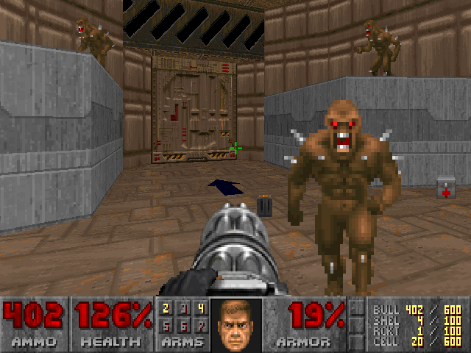
Door. Press the space bar while touching it to open.
Demons. They walk harmlessly towards you. Shoot them until they’re dead! It can take several bullets to kill a demon.
Armor. Nothing can hurt you, so you won’t need to worry about this.
Health. Nothing can hurt you, so you won’t need to worry about this.
Remaining ammunition for the currently-equipped weapon. You have unlimited ammo, so this number will never go down.

Slide 2
Door. Press the space bar while touching it to open.
Demons. They attack you!
Shoot them until they’re dead! It can take several bullets to kill a demon.
Armor. Reduces damage from attacks. Collect armor!
Health. Being hit reduces health. When health hits 0%, you die and start over. Collect medkits!
Remaining ammunition for the currently-equipped weapon.
Collect chaingun bullets and shotgun shells!
Notes:
Cover story 2 screenshot

Slide 3
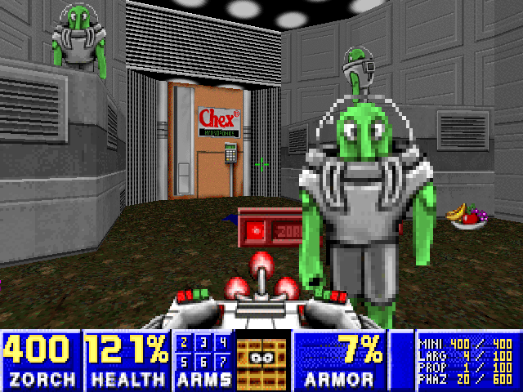
Door. Press the space bar on the keyboard while touching the door to open it.
Flemoids. They walk harmlessly towards you. Zorch them to send them safely back to their home planet. It can take several zorches to send a Flemoid home.
Armor. Nothing can slime you, so you won’t need to worry about this.
Health. Nothing can slime you, so you won’t need to worry about this.
Remaining Zorch fuel . Because you have unlimited fuel, this number will never go down.

Slide 4
Door. Press the space bar on the keyboard while touching the door to open it.
Flemoids. They throw boogers at you! Zorch them to send them safely back to their home planet. It can take several zorches to send a Flemoid home.
Armor. Helps protect you from slime. Collect armor!
Health. Being slimed reduces health. When health hits 0%, you are stuck and have to start over. Collect food!
Remaining Zorch fuel. Your Zorcher won’t work if you’re out of fuel. Collect zorch pellets and zap tapes!

